Slide 1

HEALTH INSURANCE

Slide 2

Purushotham
prathap
P Lokesh
A Lokesh
SEALIONS
Muni Bhaskar

Slide 3
AGENDA:
Abstract
Tools & Technologies
Dataset
Best Model(K-NN)
Prediction
Advantages

Slide 4

Abstract:
Why we need Health Insurance
How can we get Health Insurance
Why Health Insurance is important

Slide 5





Tools & Technologies
Python is an interpreted, high-level, general-purpose programming language. Created by Guido van Rossum and first released in 1991.
Anaconda Navigator:
is a desktop graphical user interface (GUI) included in Anaconda distribution.
The Jupyter Notebook is an open-source web application that allows you to create and share documents that contain live code, equations, visualizations and narrative text.
Node-RED provides interface between the deployment model and Graphical user Interface(GUI)

Slide 6
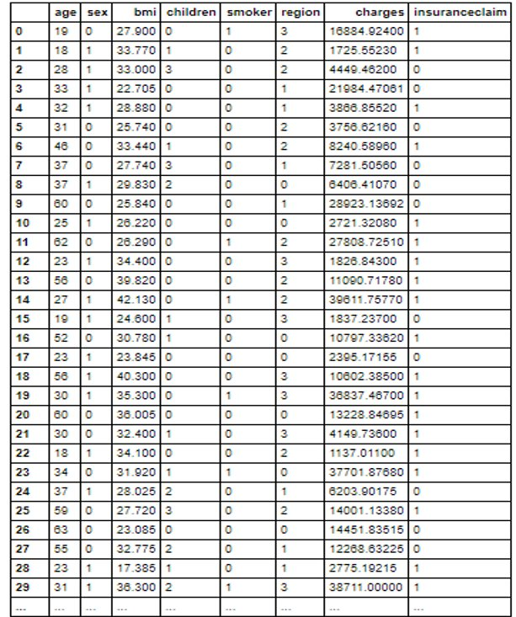
DATASET:
Supervised Data
Attributes:
Independent Attributes(inputs)
Dependent Attributes(outputs)
Model prediction
Classification Model

Slide 7
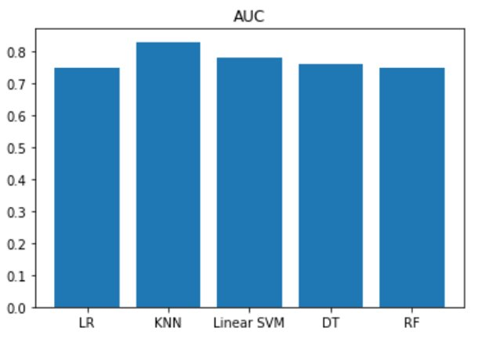
Choosing Best Model in Classification:
Logistic Regression
K-Nearest Neighbors (K-NN)
Support Vector Machine (SVM)
Random Forest
Decision tree
By observing the above bar graph we conclude that “K-NN" is the best model for our dataset.

Slide 8
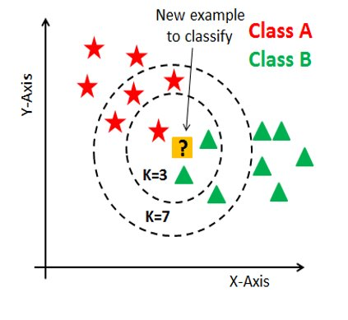
K-NN Model
What is knn model:
It classifies the new data based on similarity measure..
What is k in knn:
Number of nearest neighbors.
How does the knn algorithm works in my Model
K-Value | Accuracy
K=3 | 0.8
K=4 | 0.84
K=6 | 0.89

Slide 9
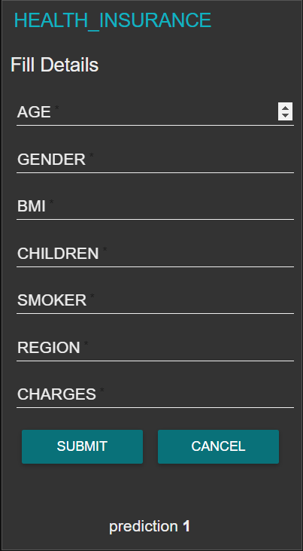
Prediction:
ENTER THE INPUTS AS ACCORDINGLY
GENDER: | FEMALE | 0
 | MALE | 1
SMOKER: | NON-SMOKER | 0
 | SMOKER | 1
REGION: | NE-US | 0
 | NW-US | 1
 | SE-US | 2
 | SW-US | 3
OUTPUT:
Click here for predict this model
or
You can directly access from the following URL
Predicted value | Result
0 | Insurance not claimed
1 | Insurance claimed
tinyurl.com/sealions143

Slide 10
Advantages:
Predicting insurance claim
Reducing time
No need of consulting insurance agent
No need of document verification(i,e Aadhar ,pan, income...)
Disadvantages:
But it is not good for all companies policies

Slide 11


